Slide 1
Deep Learning Tutorial

Slide 2
Review: L13- Image features and categorization
Visual categorization
What? Why? How?
Image features
Coverage, concision, directness
Color, gradients, textures, motion, descriptors
Histogram, feature encoding, and pooling
Image/region categorization

Slide 3
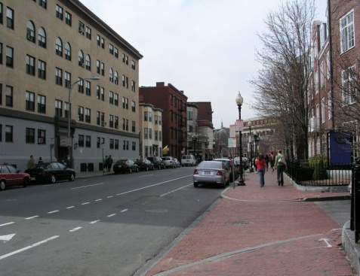
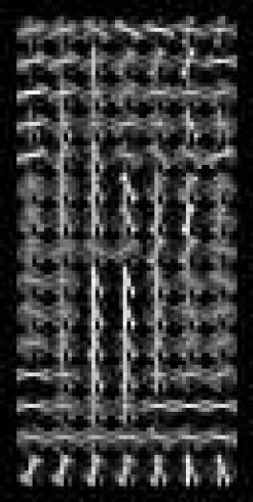
Review: L14-Object Detection
Sliding window for search
Features based on differences of intensity (gradient, wavelet, etc.)
Excellent results require careful feature design
Boosting for feature selection
Integral images, cascade for speed
Bootstrapping to deal with many, many negative examples
Stage 1
H₁(x) > t₁?
Yes
Stage 2
H₂(x) > t₂?
…
Stage N
H_{N}(x) > t_{N}?
Yes
Pass
Examples
No
No
No
Reject
Reject
Reject

Slide 4
Review: L14-Object Detection
Models can be broken down into part appearance and spatial configuration
Wide variety of models

Slide 5
Today’s class: Deep Learning Tutorial
Outline
Section 1: Introduction to Neural Network & Deep Learning
Section 2: Convolutional Neural Networks
Section 3: CNN Architectures
Section 4: Object Detection by DCNN

Slide 6
Section 1-Introduction: Outline
General concepts
Perceptron; Neuron; Activation function; Feedforward NN, deep NN,...
Loss Functions and Optimization
Loss Functions
Optimization
Gradient descent
Forward & backward prop

Slide 7
Section 1-Introduction: Outline
General concepts
Perceptron; Neuron; Activation function; Feedforward NN, deep NN,...
Loss Functions and Optimization
Loss Functions
Optimization
Forward & backward prop

Slide 8
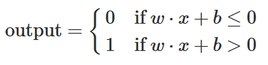
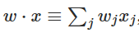
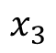
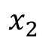
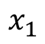
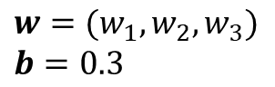
Perceptron
Basic building block for NN composition is a perceptron (Rosenblatt c.1960)
Linear classifier – vector of weights w and a ‘bias’ b
$$x_{1}$$
$$w=(w_{1},w_{2},w_{3})$$
$$b=0.3$$
$$x_{2}$$
Output (binary)
$$x_{3}$$

Slide 9
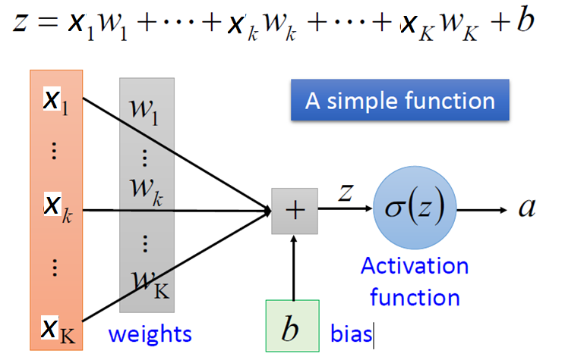
Neuron
a: activation output of neuron;
z: output of neuron

Slide 10
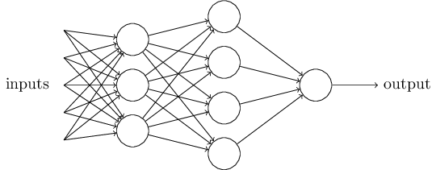
Neural Networks (NN) - Composition
Activation outputs from one neuron are fed into inputs of another neuron.
Each neurons can have different values of weights and biases.
Attempt to represent complex functions as compositions of smaller functions.

Slide 11
Neural Networks - Composition
Layer 1
Layer 2
Output Layer
Network architecture: Sets of layers and the connections (weights) between them.

Slide 12
Neural Networks-Composition
Hidden Layer 1
Hidden Layer 2
Output Layer
Hidden layers: Layers that are in between the input and the output.

Slide 13
Activation function
If the activation functions are all linear functions, we have formed chains of linear functions.
It can hardly represent a complex nonlinear mapping.

Slide 14
Activation function
Hidden Layer 1
Hidden Layer 2
x
Vector!
Matrix!
Vector!
Matrix!
Vector!
It’s all just matrix multiplication!

Slide 15
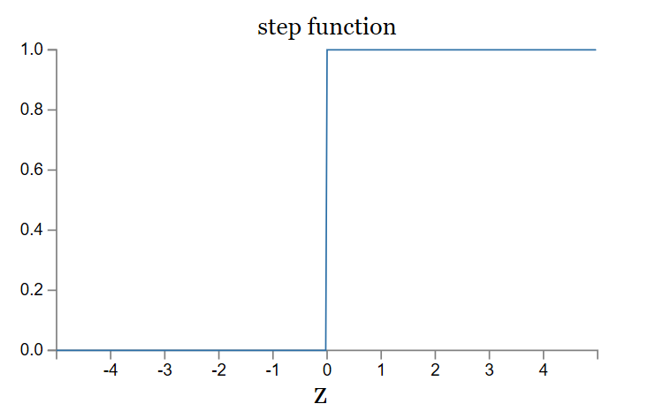
Activation function
NN needs simple nonlinear activation functions.
Step activation function
small change in input can cause large change in (binary) output.
Activation function

Slide 16
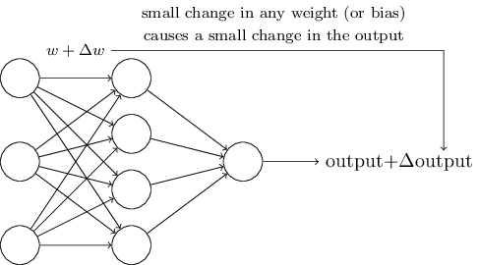
Activation function
Step activation function
small change in input can cause large change in (binary) output.
We want:

Slide 17
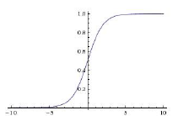
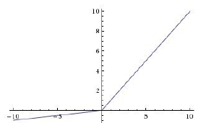
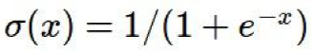
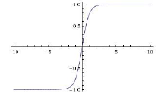
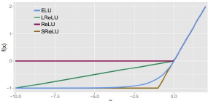
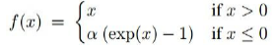
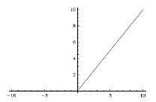
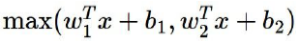
Activation function
Leaky ReLU
max(0.1x, x)
Sigmoid
tanh
tanh(x)
ELU
ReLU
max(0,x)
Maxout

Slide 18
Fully Connect Feedforward NN
Hidden Layer 1
Hidden Layer 2
Feedforward: Information flows through the input (layer), through the intermediate layers, and finally to the output layers. No feedback.
Fully Connect: each neuron in the layer i is connected to every neuron in the layer i-1.

Slide 19
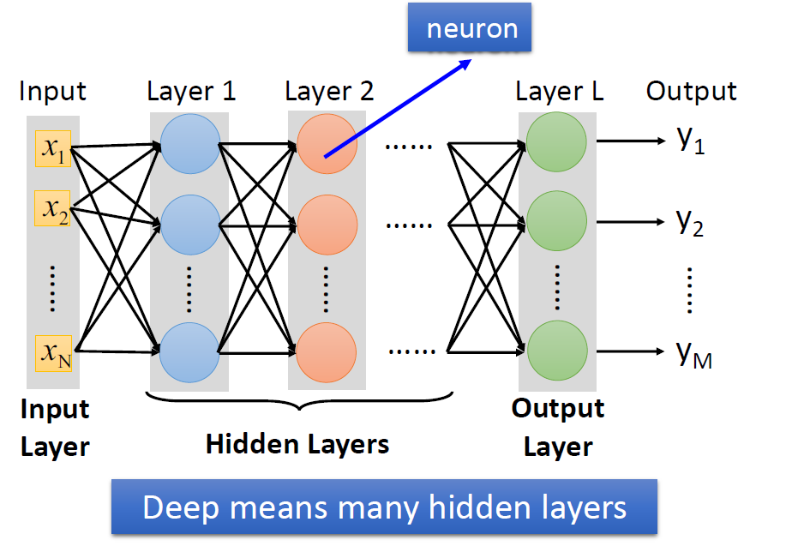
Deep NN

Slide 20
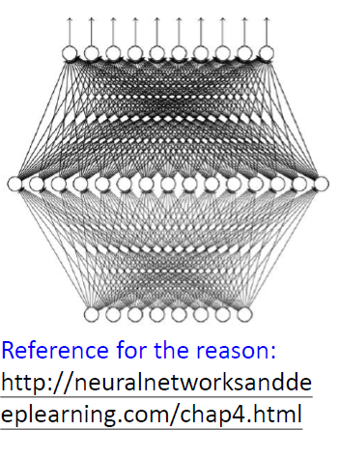
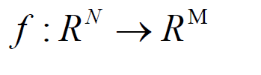
Why deep?
Universality Theorem (Hornik et al.,
1989; Cybenko, 1989):
Any continuous function f
Can be realized by a network with one hidden layer.
So long as it is differentiable;
Given enough hidden neurons;
Why “Deep” neural network not “Fat” neural network?

Slide 21
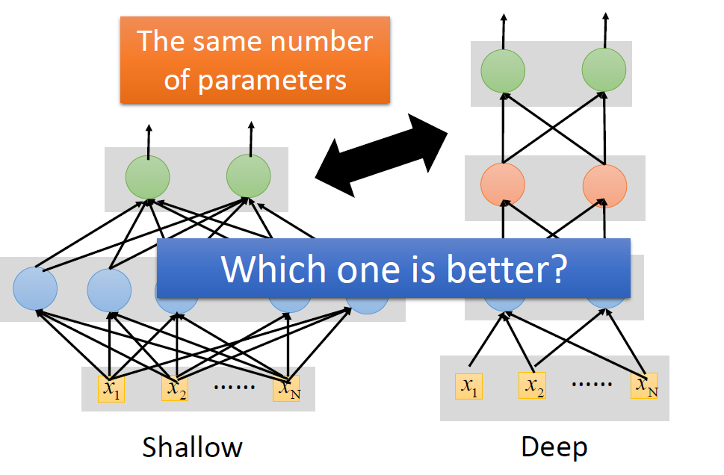
Why deep?
A shallow (one hidden layer) NN can represent a complex function function, but the layer may be very large and may fail to learn.
A complex function may involve composition of several simpler functions.
Empirically, deep NN do a better job than shallow NN at learning such hierarchies of knowledge.
Intuitively, deep composition is efficient because it allows reuse.

Slide 22
Why DNN is taking off?
Huge (labeled) data;
Fast computation power;
Development of NN algorithm.
Difficulties in DNN learning?
Local minima;
Vanishing gradient /exploding gradient;
...

Slide 23
Section 1-Introduction: Outline
General concepts
Perceptron; Neuron; Activation function; Feedforward NN, deep NN,...
Loss Functions and Optimization
Loss Functions
Optimization
Gradient descent
Forward & backward prop

Slide 24
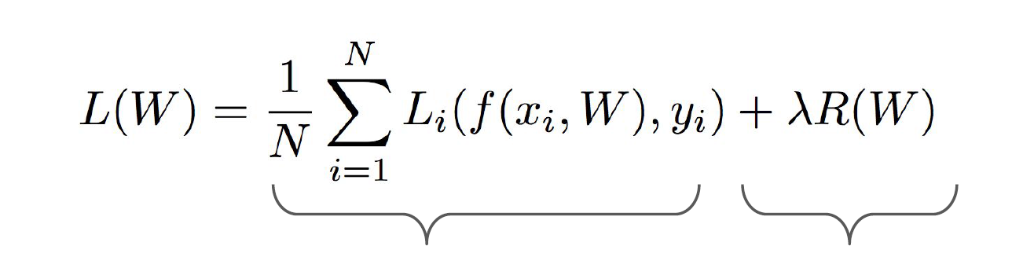
Loss Functions
Total loss function will often combine the data loss functions with a regularization term.
Data loss: Model predictions
should match training data
Regularization: Model
should be “simple”, so it
works on test data

Slide 25
Loss Functions- data loss
Total loss function will often combine the data loss functions with a regularization term.
The DNN model defines a distribution p(y | x; θ ) maximum likelihood.
Using the cross-entropy between the training data and the model’s predictions as the data loss function.
The output layer determines the form of the cross-entropy function.

Slide 26
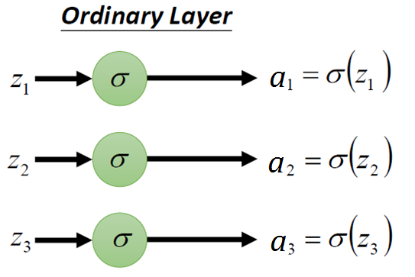
Loss Functions- data loss
• Ordinary output layer
Activation function is identity function : .
Linear output layer.
Linear output layer is used to produce the mean of a conditional Gaussian distribution.
Its data loss function is the mean squared error(MSE):
Often used for regression.

Slide 27
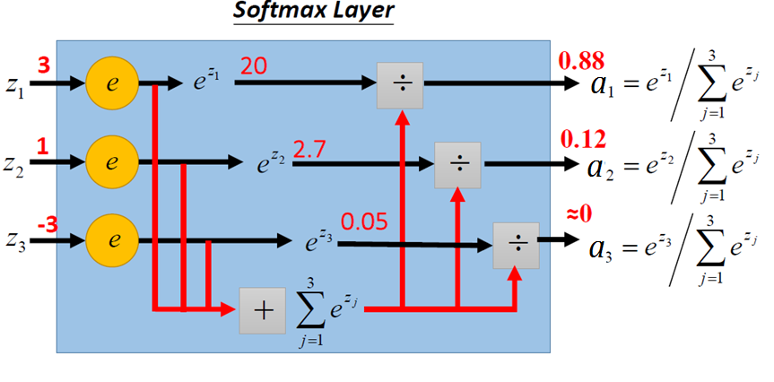
Loss Functions- data loss
• Softmax output layer
Activation function :
Nonlinear output layer.
Its data loss function is the cross-entropy function:
Often used for classification.

Slide 28
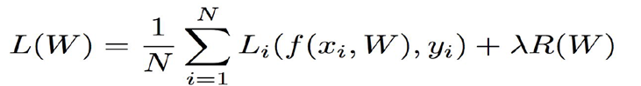
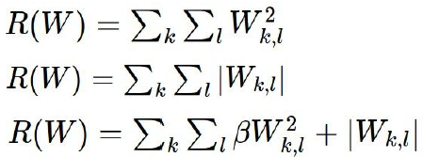
Loss Functions- regularization
Weight decay
In common use:
L2 regularization
L1 regularization
Elastic net (L1 + L2)
Max norm regularization
Dropout

Slide 29
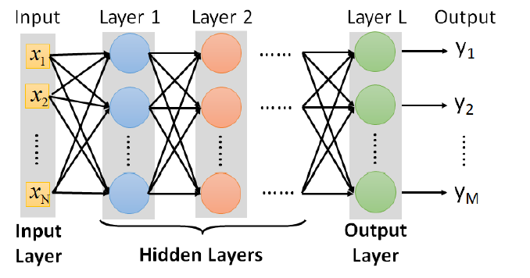

FAQ
• Q: How many layers? How many neurons for each layer?
• Q: Can the structure be automatically determined?

Slide 30
Section 1-Introduction: Outline
General concepts
Perceptron; Neuron; Activation function; Feedforward NN, deep NN,...
Loss Functions and Optimization
Loss Functions
Optimization
Gradient descent
Forward & backward prop

Slide 31

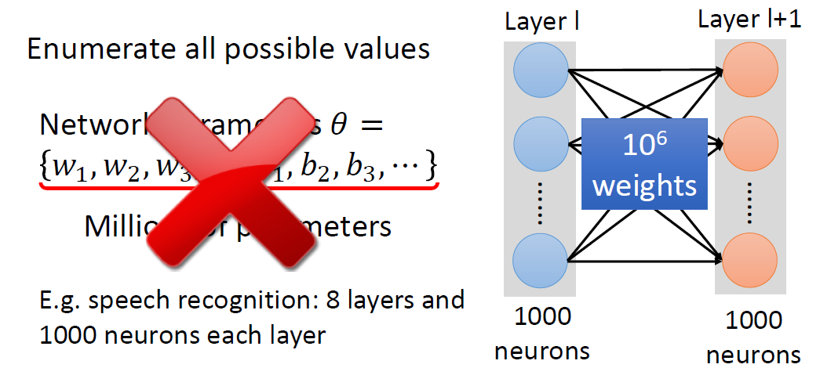
How to pick the best params

Slide 32
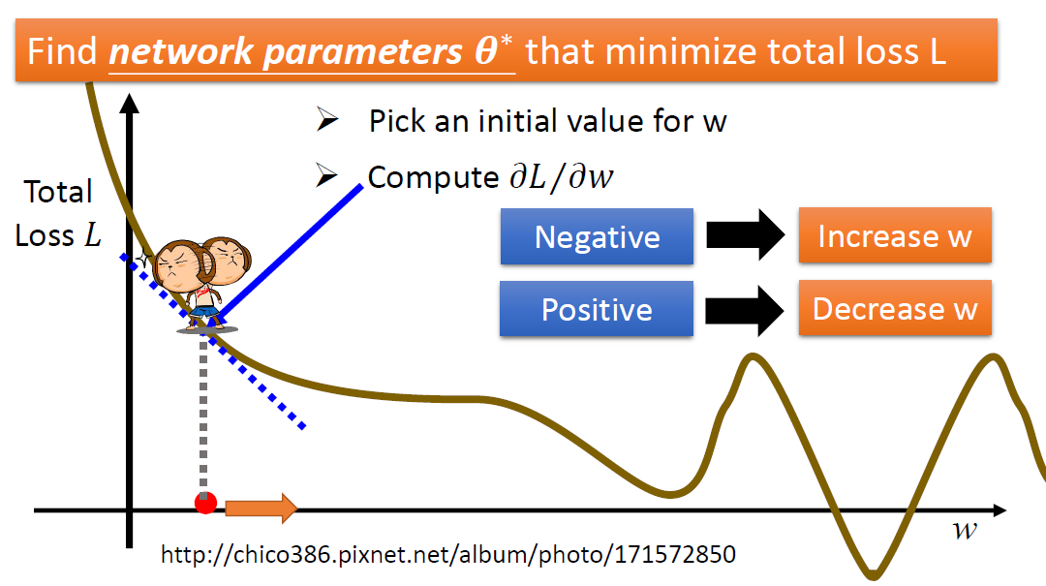
Gradient Descent

Slide 33
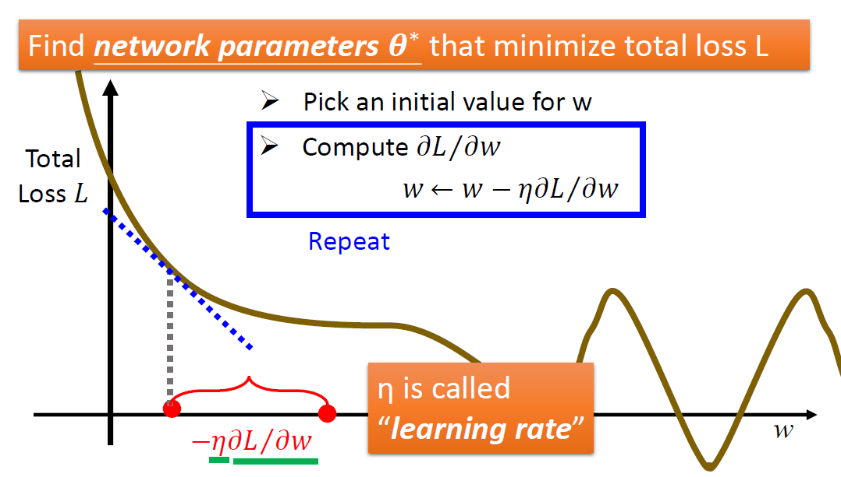
Gradient Descent

Slide 34
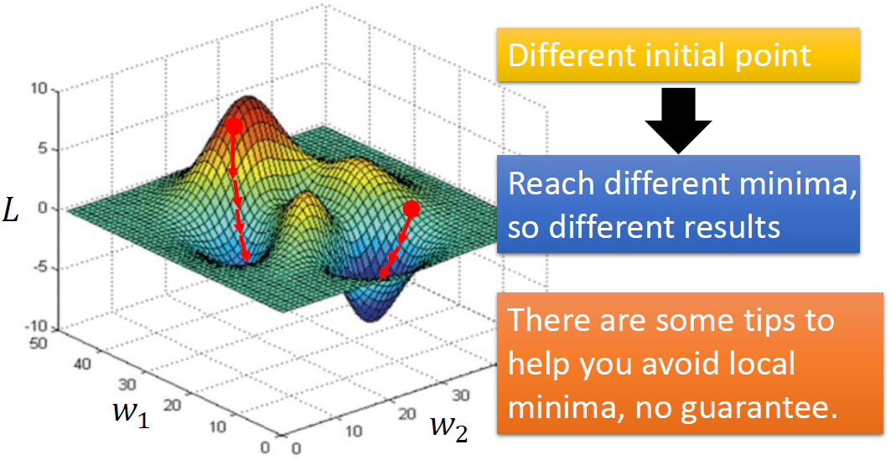
Gradient Descent - Difficulty
• Gradient descent never guarantee global minima

Slide 35
Gradient Descent
Mini-batch SGD
Loop:
1. Sample a batch of data
2. Forward prop it through the graph, get loss
3. Backprop to calculate the gradients
4. Update the parameters using the gradient

Slide 36
Section 1-Introduction: Outline
General concepts
Perceptron; Neuron; Activation function; Feedforward NN, deep NN,...
Loss Functions and Optimization
Loss Functions
Optimization
Gradient descent
Forward & backward prop

Slide 37
Forward & backward prop
input Layer 1 Layer 2 Output Layer Loss
,...,
Forward prop:
compute an output for a input.
Backward prop:
compute the gradient

Slide 38
backward prop
input Layer 1 Layer 2 Output Layer Loss
,...,
,...,
chain rule
Backward prop: compute the gradient.
define:
case 1: i=l,
case 2: i!=l,

Slide 39
Forward & Backward prop
input Layer 1 Layer 2 Output Layer Loss
,...,
,...,
chain rule
Backward prop: compute the gradient.

Slide 40
backward prop
input Layer 1 Layer 2 Output Layer Loss
,...,
,...,
chain rule
Backward prop: compute the gradient.
Vanishing gradient
exploding gradient

Slide 41
Tips for training DNN
- Activation Functions (use ReLU)
- Data Preprocessing (images: subtract mean)
- Weight Initialization (use Xavier init)
- Batch Normalization (use)
- Babysitting the Learning process
- Hyperparameter Optimization
(random sample hyperparams, in log space when appropriate)

Slide 42
Tips for training DNN (continue)
Fancier optimization
Momentum, RMSProp, Adam, etc
Learning rate decay
Regularization
Weight decay
Batch Normalization
Dropout
Data augmentation
...
Transfer Learning
Transfer learning with CNNs is pervasive

Slide 43
Summary: Section 1-Introduction
Neutron is the basic building block for NN composition.
DNN outperforms than shallow NN.
ReLU is the most used activation function in DNN.
Total loss function often combine the data loss functions with a regularization.
Backward prop: recursive application of the chain rule to compute the gradients of all inputs/parameters/intermediates
Forward prop: compute result of an operation and save any intermediates needed for gradient computation in memory

Slide 44
Section 2
Convolutional Neural Networks

Slide 45
Section 2-DCNN: Outline
A brief introduction
Convolution layer
Pooling layer
Backward prop in CNN

Slide 46
Section 2-DCNN: Outline
A brief introduction
Convolution layer
Pooling layer
Backward prop in CNN

Slide 47
Convolutional networks
A degenerative version of FC-NN;
ConvNets stack CONV, POOL, FC layers;
Contain at least one convolution layer;
Use convolution in place of general matrix multiplication
Widely used in computer vision, speech recognition and NLP.
Gradient-based learning applied to document recognition [LeCun, Bottou, Bengio, Haffner 1998]

Slide 48
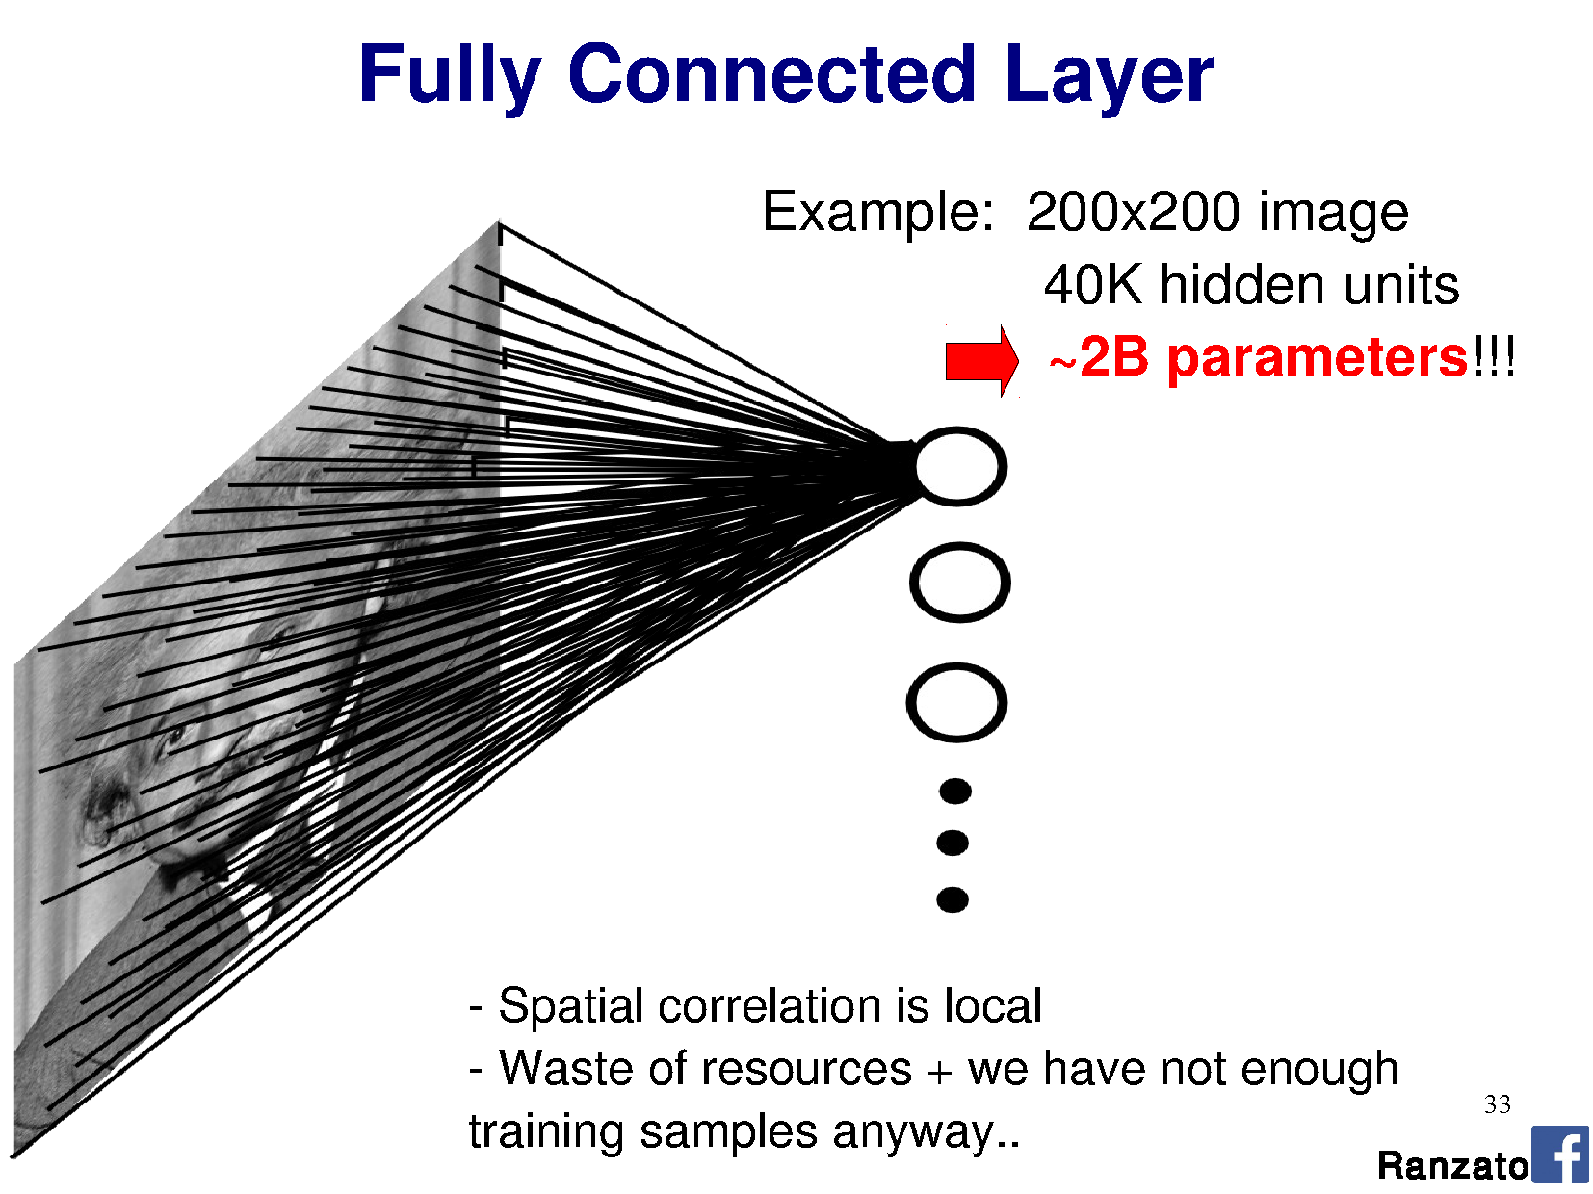
Why CNN: Images as input to neural networks
Notes:
Seems fine, right?
Going to learn a neural network to classify an image. Learn weights from a large database of images using back propagation.
How many perceptrons do you think we need to represent the ‘complexity’ of natural images?
How big are the weight matrices?
How many weight parameters did you learn in your HOG-based SVM classification? How big was the database? Did it work?
The more parameters we have, the larger the database we need to ‘map out’ the high-dimensional space.
Are we wasting any knowledge in this representation?

Slide 49
Why CNN

Slide 50
Why CNN

Slide 51
Motivation
Sparse interactions – receptive fields
Assume that in an image, we care about ‘local neighborhoods’ only for a given neural network layer.
Composition of layers will expand local -> global.

Slide 52
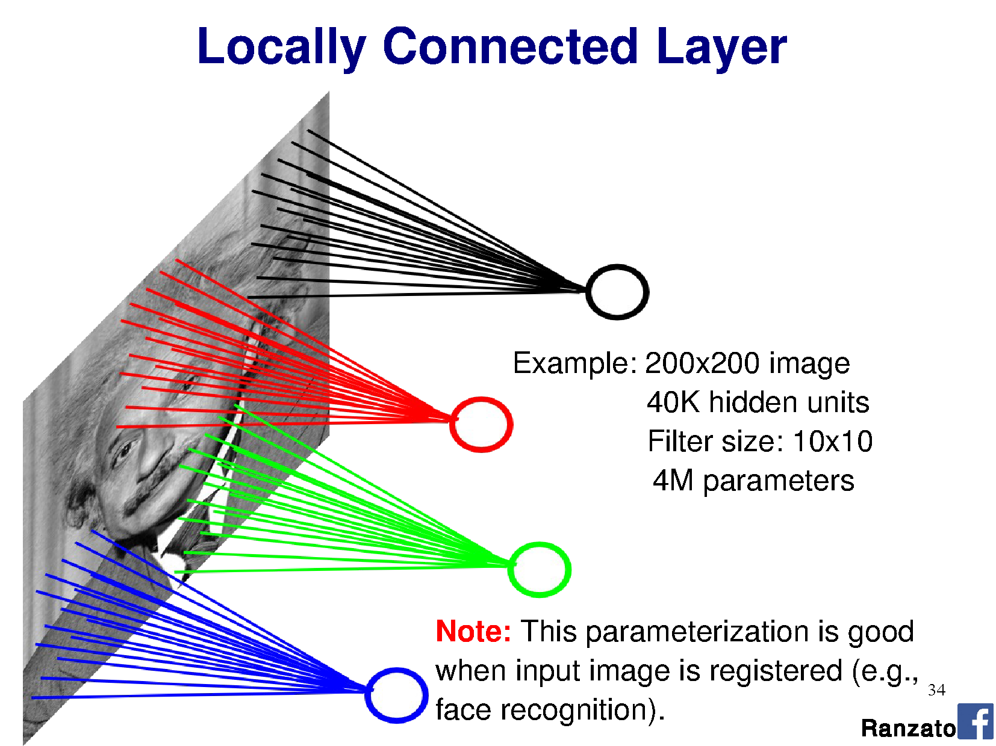
Why CNN
Local connectivity

Slide 53
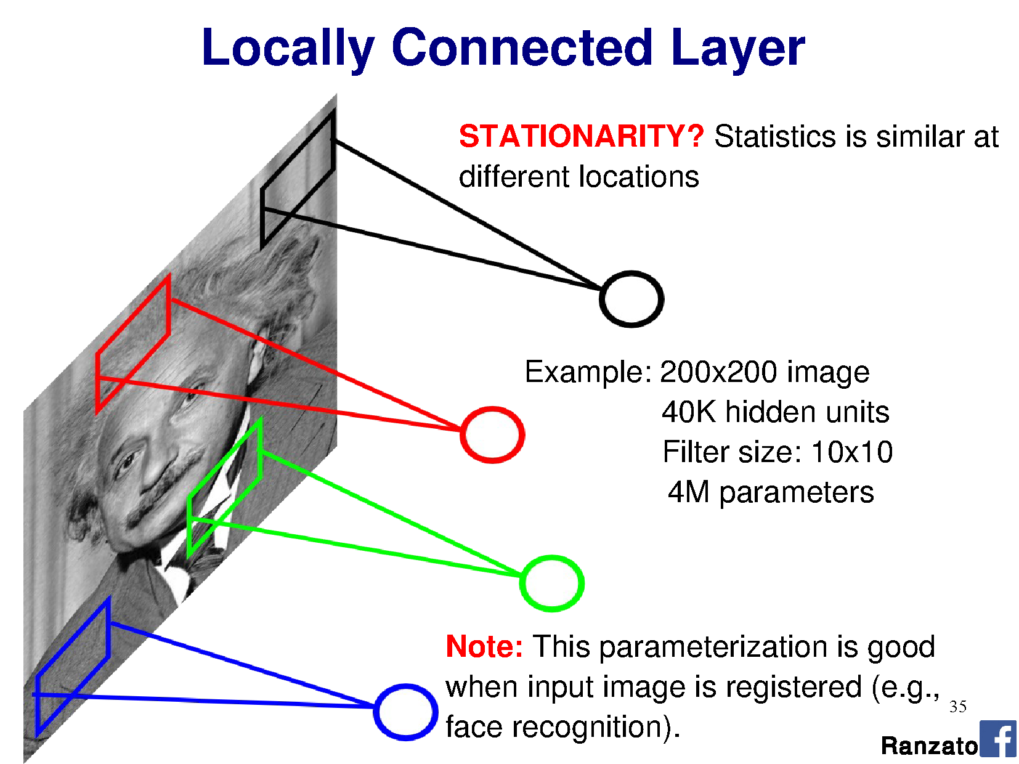
Why CNN

Slide 54
Motivation
Sparse interactions – receptive fields
Assume that in an image, we care about ‘local neighborhoods’ only for a given neural network layer.
Composition of layers will expand local -> global.
Parameter sharing
‘Tied weights’ – use same weights (filters) for more than one neutron in the layer.
Leads to equivariant representation
If input changes (e.g., translates), then output changes similarly

Slide 55
Why CNN
Local connectivity
Parameter sharing
100

Slide 56
Filtering reminder: Correlation (rotated convolution)
1
1
1
1
1
1
1
1
1
0 | 0 | 0 | 0 | 0 | 0 | 0 | 0 | 0 | 0
0 | 0 | 0 | 0 | 0 | 0 | 0 | 0 | 0 | 0
0 | 0 | 0 | 90 | 90 | 90 | 90 | 90 | 0 | 0
0 | 0 | 0 | 90 | 90 | 90 | 90 | 90 | 0 | 0
0 | 0 | 0 | 90 | 90 | 90 | 90 | 90 | 0 | 0
0 | 0 | 0 | 90 | 0 | 90 | 90 | 90 | 0 | 0
0 | 0 | 0 | 90 | 90 | 90 | 90 | 90 | 0 | 0
0 | 0 | 0 | 0 | 0 | 0 | 0 | 0 | 0 | 0
0 | 0 | 90 | 0 | 0 | 0 | 0 | 0 | 0 | 0
0 | 0 | 0 | 0 | 0 | 0 | 0 | 0 | 0 | 0
 | 0 | 10 | 20 | 30 | 30 | 30 | 20 | 10
 | 0 | 20 | 40 | 60 | 60 | 60 | 40 | 20
 | 0 | 30 | 60 | 90 | 90 | 90 | 60 | 30
 | 0 | 30 | 50 | 80 | 80 | 90 | 60 | 30
 | 0 | 30 | 50 | 80 | 80 | 90 | 60 | 30
 | 0 | 20 | 30 | 50 | 50 | 60 | 40 | 20
 | 10 | 20 | 30 | 30 | 30 | 30 | 20 | 10
 | 10 | 10 | 10 | 0 | 0 | 0 | 0 | 0
Notes:
Correlation / convolution -> same thing for symmetric filters.
Many deep learning libraries use correlation but call it convolution. NBD. We can learn the difference (rotation) away

Slide 57
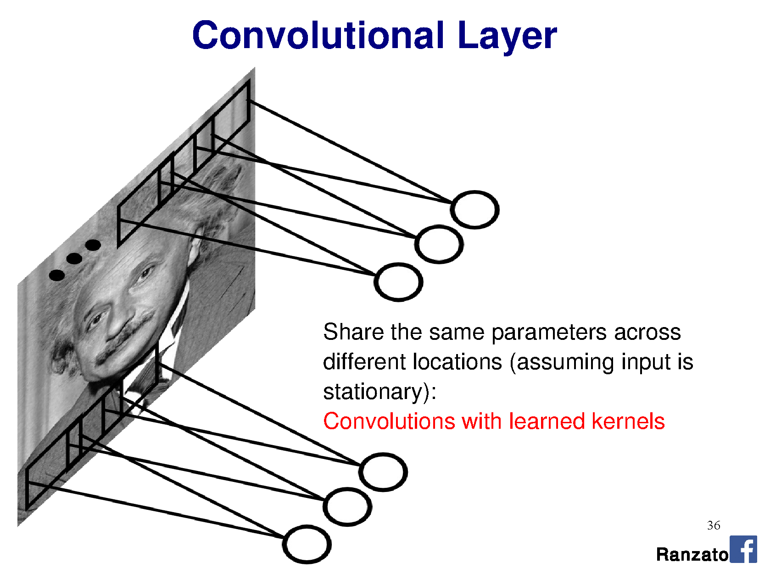
Care about ‘local’ only

Slide 58
Section 2-DCNN: Outline
A brief introduction
Convolution layer
Pooling layer
Backward prop in CNN

Slide 59
Convolution Layer
32x32x3 image
32
height
32
width
3
depth

Slide 60
Convolution Layer
32x32x3 image
5x5x3 filter
32
height
Convolve the filter with the image
i.e. “slide over the image spatially,
computing dot products”
32
width
3
depth

Slide 61
Convolution Layer
Filters always extend the full
depth of the input volume
32x32x3 image
5x5x3 filter
32
height
Convolve the filter with the image
i.e. “slide over the image spatially,
computing dot products”
32
width
3
depth

Slide 62
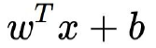
Convolution Layer
32x32x3 image
5x5x3 filter w
32
1 number:
the result of taking a dot product between the
filter and a small 5x5x3 chunk of the image
(i.e. 5*5*3 = 75-dimensional dot product + bias)
32
3

Slide 63
Convolution Layer
activation map
32x32x3 image
5x5x3 filter
28
32
convolve (slide) over all
spatial locations
32
28
3
1

Slide 64
Convolution Layer
consider a second, green filter
activation maps
32x32x3 image
5x5x3 filter
28
32
convolve (slide) over all
spatial locations
32
28
3
2

Slide 65
Convolution Layer
For example, if we have 6 5x5x3 filters, we’ll get 6 separate activation maps
28
28
32
Convolution Layer
32
28
3
6
activation maps
We stack these up to get a “new image” of size 28x28x6!

Slide 66
Convolution Layer
Preview: ConvNet is a sequence of Convolution Layers, interspersed with
activation functions
32
28
CONV,
ReLU
e.g. 6
5x5x3
filters
32
28
3
6

Slide 67
Convolution Layer
Preview: ConvNet is a sequence of Convolutional Layers, interspersed with
activation functions
32
28
24
….
CONV,
ReLU
e.g. 6
5x5x3
filters
CONV,
ReLU
e.g. 10
5x5x6
filters
CONV,
ReLU
32
28
24
3
6
10

Slide 68
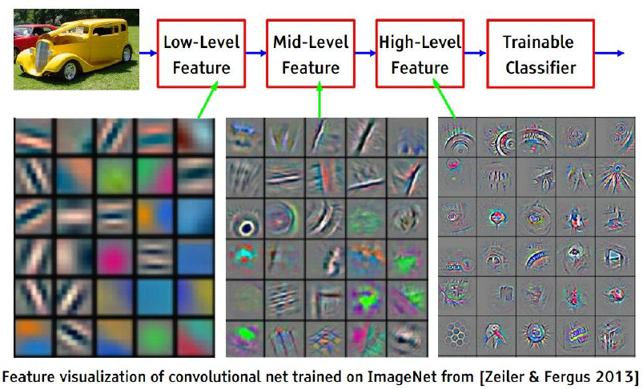
Convolution Layer

Slide 69
Convolution Layer
A closer look at spatial dimensions:
activation map
32x32x3 image
5x5x3 filter
28
32
convolve (slide) over all
spatial locations
28
32
3
1

Slide 70
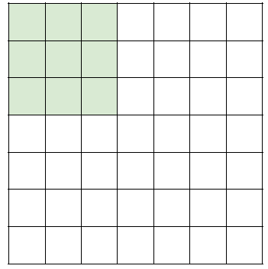
Convolution Layer
A closer look at spatial dimensions:
7
7x7 input (spatially)
assume 3x3 filter
7

Slide 71
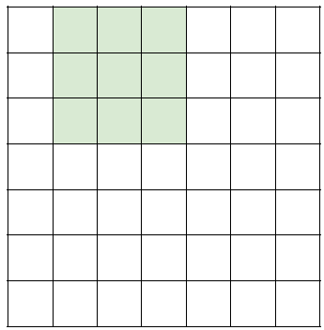
Convolution Layer
A closer look at spatial dimensions:
7
7x7 input (spatially)
assume 3x3 filter
7

Slide 72
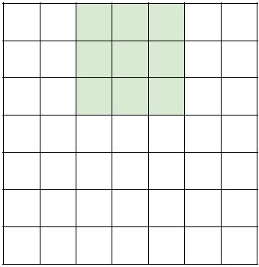
Convolution Layer
A closer look at spatial dimensions:
7
7x7 input (spatially)
assume 3x3 filter
7

Slide 73
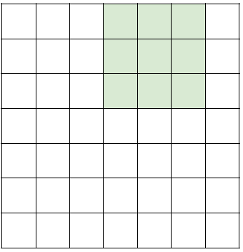
Convolution Layer
A closer look at spatial dimensions:
7
7x7 input (spatially)
assume 3x3 filter
7

Slide 74

Convolution Layer
A closer look at spatial dimensions:
7
7x7 input (spatially)
assume 3x3 filter
=> 5x5 output
7

Slide 75
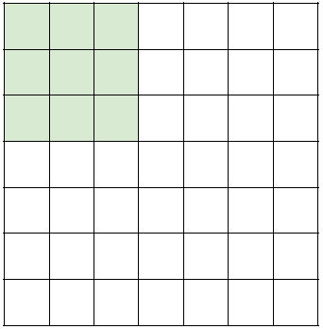
Convolution Layer
A closer look at spatial dimensions:
7
7x7 input (spatially)
assume 3x3 filter
applied with stride 2
7

Slide 76
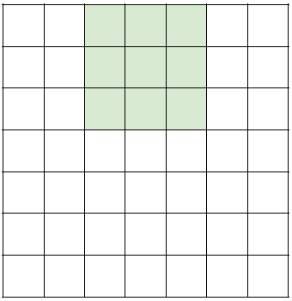
Convolution Layer
A closer look at spatial dimensions:
7
7x7 input (spatially)
assume 3x3 filter
applied with stride 2
7

Slide 77
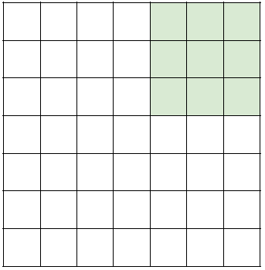
Convolution Layer
A closer look at spatial dimensions:
7
7x7 input (spatially)
assume 3x3 filter
applied with stride 2
=> 3x3 output!
7

Slide 78
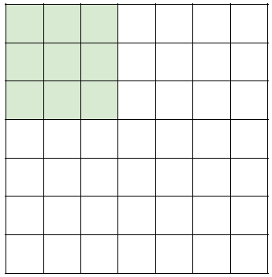
Convolution Layer
A closer look at spatial dimensions:
7
7x7 input (spatially)
assume 3x3 filter
applied with stride 3
7

Slide 79
Convolution Layer
A closer look at spatial dimensions:
7
7x7 input (spatially)
assume 3x3 filter
applied with stride 3 ?
doesn’t fit!
cannot apply 3x3 filter on
7x7 input with stride 3.
7

Slide 80
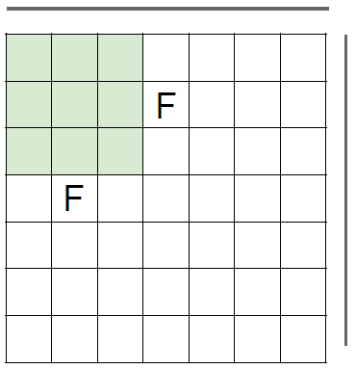
Convolution Layer
A closer look at spatial dimensions:
N
Output size:
(N - F) / stride + 1
N
e.g. N = 7, F = 3:
stride 1 => (7 - 3)/1 + 1 = 5
stride 2 => (7 - 3)/2 + 1 = 3
stride 3 => (7 - 3)/3 + 1 = 2.33 :\

Slide 81
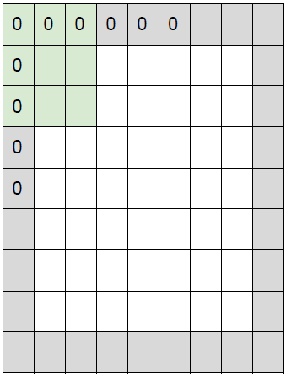
Convolution Layer
In practice: Common to zero pad the border
e.g. input 7x7
3x3 filter, applied with stride 1
pad with 1 pixel border => what is the output?
(recall:)
(N - F) / stride + 1

Slide 82
Convolution Layer
In practice: Common to zero pad the border
e.g. input 7x7
3x3 filter, applied with stride 1
pad with 1 pixel border => what is the output?
7x7 output!

Slide 83
Convolution Layer
In practice: Common to zero pad the border
e.g. input 7x7
3x3 filter, applied with stride 1
pad with 1 pixel border => 7x7 output
in general, common to see CONV layers with
stride 1, filters of size FxF, and zero-padding with
(F-1)/2. (will preserve size spatially)
e.g. F = 3 => zero pad with 1
F = 5 => zero pad with 2
F = 7 => zero pad with 3

Slide 84
Convolution Layer
Remember back to…
E.g. 32x32 input convolved repeatedly with 5x5 filters shrinks volumes spatially!
(32 -> 28 -> 24 ...). Shrinking too fast is not good, doesn’t work well.
32
28
24
….
CONV,
ReLU
e.g. 6
5x5x3
filters
CONV,
ReLU
e.g. 10
5x5x6
filters
CONV,
ReLU
32
28
24
3
6
10

Slide 85
Examples
Input volume: 32x32x3
10 5x5x3 filters with stride 1, pad 2
Output volume size: ?

Slide 86
Examples
Input volume: 32x32x3
10 5x5x3 filters with stride 1, pad 2
Output volume size:
(32+2*2-5)/1+1 = 32 spatially, so
32x32x10

Slide 87
Examples
Input volume: 32x32x3
10 5x5 filters with stride 1, pad 2
Number of parameters in this layer?

Slide 88
Examples
Input volume: 32x32x3
10 5x5x3 filters with stride 1, pad 2
Number of parameters in this layer?
each filter has 5*5*3 + 1 = 76 params (+1 for bias)
=> 76*10 = 760

Slide 89

Convolution Layer

Slide 90
Convolution Layer
Common settings:
K = (powers of 2, e.g. 32, 64, 128, 512)
- F = 3, S = 1, P = 1
- F = 5, S = 1, P = 2
- F = 1, S = 1, P = 0

Slide 91
Section 2-DCNN: Outline
A brief introduction
Convolution layer
Pooling layer
Backward prop in CNN

Slide 92

Pooling Layer
makes the representations smaller and more manageable;
operates over each activation map independently;
max pooling, average pooling,...,

Slide 93


Pooling Layer
Max pooling
Single depth slice
max pool with 2x2 filters
and stride 2

Slide 94

Pooling Layer

Slide 95
Pooling Layer
Common settings:
F = 2, S = 2
F = 3, S = 2

Slide 96


Slide 97


Slide 98

Fully Connected Layer (FC layer)
Contains neurons that connect to the entire input volume, as in ordinary Neural Networks

Slide 99
Section 2-DCNN: Outline
A brief introduction
Convolution layer
Pooling layer
Backward prop in CNN

Slide 100
Backward prop in CNN
input Layer 1 Layer 2 Output Layer Loss
,...,
,...,
chain rule
Backward prop: compute the gradient, define:
=L (current layer is the output layer);
Layer is a pooling layer;
layer is a convolution layer.
?

Slide 101
Backward prop in CNN
Layer l-1
Layer l
layer is a pooling layer:
Forward prop: downsample

Slide 102





Backward prop in CNN
Layer i-1
Layer i
-th layer is a convolution layer:
Forward prop:
Backward prop:
Then, we can obtain all delta. For the l-th layer:

Slide 103
Section 2-DCNN: Summary
ConvNets stack CONV, POOL, FC layers;
Local connectivity;
Parameter sharing
Trend towards smaller filters and deeper architectures;
Trend towards getting rid of POOL/FC layers (just CONV);
Typical architectures look like
[(CONV-RELU)*N-POOL?]*M-(FC-RELU)*K,SOFTMAX
where N is usually up to ~5, M is large, 0 <= K <= 2.
but recent advances such as ResNet/GoogLeNet challenge this paradigm.

Slide 104
Section 3: CNN Architectures
Lecture 9 -
1
Fei-Fei Li & Justin Johnson & Serena Yeung Lecture 9 - May 2, 2017

Slide 105
Section 3-CNN Architectures: Outline
Case Studies
AlexNet
VGG
GoogLeNet
ResNet
Also....
NiN (Network in Network)
Wide ResNet
ResNeXT
Stochastic Depth
DenseNet
FractalNet
SqueezeNet
Lecture 9 -
105

Slide 106

Review: LeNet-5
[LeCun et al., 1998]
Conv filters were 5x5, applied at stride 1
Subsampling (Pooling) layers were 2x2 applied at stride 2
i.e. architecture is [CONV-POOL-CONV-POOL-FC-FC]
Lecture 9 -
106

Slide 107

Case Study: AlexNet
[Krizhevsky et al. 2012]
Architecture:
CONV1 MAX POOL1 NORM1 CONV2 MAX POOL2 NORM2 CONV3 CONV4 CONV5
Max POOL3 FC6
FC7 FC8
Lecture 9 - 107
Fei-Fei Li & Justin Johnson & Serena Yeung Lecture 9 - May 2, 2017

Slide 108
Case Study: AlexNet
[Krizhevsky et al. 2012]
Input: 227x227x3 images
First layer (CONV1): 96 11x11 filters applied at stride 4
=>
Q: what is the output volume size? Hint: (227-11)/4+1 = 55
Lecture 9 - 108
Fei-Fei Li & Justin Johnson & Serena Yeung Lecture 9 - May 2, 2017

Slide 109
Case Study: AlexNet
[Krizhevsky et al. 2012]
Input: 227x227x3 images
First layer (CONV1): 96 11x11 filters applied at stride 4
=>
Output volume [55x55x96]
Q: What is the total number of parameters in this layer?
Lecture 9 - 109
Fei-Fei Li & Justin Johnson & Serena Yeung Lecture 9 - May 2, 2017

Slide 110
Case Study: AlexNet
[Krizhevsky et al. 2012]
Input: 227x227x3 images
First layer (CONV1): 96 11x11 filters applied at stride 4
=>
Output volume [55x55x96]
Parameters: (11*11*3)*96 = 35K
Lecture 9 - 110
Fei-Fei Li & Justin Johnson & Serena Yeung Lecture 9 - May 2, 2017

Slide 111
Case Study: AlexNet
[Krizhevsky et al. 2012]
Input: 227x227x3 images After CONV1: 55x55x96
Second layer (POOL1): 3x3 filters applied at stride 2 Q: what is the output volume size? Hint: (55-3)/2+1 = 27
Lecture 9 - 111

Slide 112
Case Study: AlexNet
[Krizhevsky et al. 2012]
Input: 227x227x3 images After CONV1: 55x55x96
Second layer (POOL1): 3x3 filters applied at stride 2 Output volume: 27x27x96
Q: what is the number of parameters in this layer?
Lecture 9 - 112
Fei-Fei Li & Justin Johnson & Serena Yeung Lecture 9 - May 2, 2017

Slide 113
Case Study: AlexNet
[Krizhevsky et al. 2012]
Input: 227x227x3 images After CONV1: 55x55x96
Second layer (POOL1): 3x3 filters applied at stride 2 Output volume: 27x27x96
Parameters: 0!
Lecture 9 - 113
Fei-Fei Li & Justin Johnson & Serena Yeung Lecture 9 - May 2, 2017

Slide 114
Case Study: AlexNet
[Krizhevsky et al. 2012]
Input: 227x227x3 images After CONV1: 55x55x96 After POOL1: 27x27x96
...
Lecture 9 - 114
Fei-Fei Li & Justin Johnson & Serena Yeung Lecture 9 - May 2, 2017

Slide 115
Case Study: AlexNet
[Krizhevsky et al. 2012]
Full (simplified) AlexNet architecture: [227x227x3] INPUT
[55x55x96] CONV1: 96 11x11 filters at stride 4, pad 0 [27x27x96] MAX POOL1: 3x3 filters at stride 2 [27x27x96] NORM1: Normalization layer
[27x27x256] CONV2: 256 5x5 filters at stride 1, pad 2 [13x13x256] MAX POOL2: 3x3 filters at stride 2 [13x13x256] NORM2: Normalization layer [13x13x384] CONV3: 384 3x3 filters at stride 1, pad 1 [13x13x384] CONV4: 384 3x3 filters at stride 1, pad 1 [13x13x256] CONV5: 256 3x3 filters at stride 1, pad 1 [6x6x256] MAX POOL3: 3x3 filters at stride 2
[4096] FC6: 4096 neurons
[4096] FC7: 4096 neurons
[1000] FC8: 1000 neurons (class scores)
Lecture 9 -
Fei-Fei Li & Justin Johnson & Serena Yeung Lecture 9 - May 2, 2017

Slide 116
Case Study: AlexNet
[Krizhevsky et al. 2012]
Full (simplified) AlexNet architecture: [227x227x3] INPUT
[55x55x96] CONV1: 96 11x11 filters at stride 4, pad 0 [27x27x96] MAX POOL1: 3x3 filters at stride 2 [27x27x96] NORM1: Normalization layer
[27x27x256] CONV2: 256 5x5 filters at stride 1, pad 2 [13x13x256] MAX POOL2: 3x3 filters at stride 2 [13x13x256] NORM2: Normalization layer [13x13x384] CONV3: 384 3x3 filters at stride 1, pad 1 [13x13x384] CONV4: 384 3x3 filters at stride 1, pad 1 [13x13x256] CONV5: 256 3x3 filters at stride 1, pad 1 [6x6x256] MAX POOL3: 3x3 filters at stride 2
Details/Retrospectives:
first use of ReLU
used Norm layers (not common anymore)
heavy data augmentation
dropout 0.5
batch size 128
SGD Momentum 0.9
Learning rate 1e-2, reduced by 10 manually when val accuracy plateaus
L2 weight decay 5e-4
7 CNN ensemble: 18.2% -> 15.4%
[4096] FC6: 4096 neurons
[4096] FC7: 4096 neurons
[1000] FC8: 1000 neurons (class scores)

Slide 117
Case Study: AlexNet
[Krizhevsky et al. 2012]
Full (simplified) AlexNet architecture: [227x227x3] INPUT
[55x55x96] CONV1: 96 11x11 filters at stride 4, pad 0 [27x27x96] MAX POOL1: 3x3 filters at stride 2
[55x55x48] x 2
[27x27x96] NORM1: Normalization layer
[27x27x256] CONV2: 256 5x5 filters at stride 1, pad 2 [13x13x256] MAX POOL2: 3x3 filters at stride 2 [13x13x256] NORM2: Normalization layer [13x13x384] CONV3: 384 3x3 filters at stride 1, pad 1 [13x13x384] CONV4: 384 3x3 filters at stride 1, pad 1 [13x13x256] CONV5: 256 3x3 filters at stride 1, pad 1
Historical note: Trained on GTX 580 GPU with only 3 GB of memory.
Network spread across 2 GPUs, half the neurons (feature maps) on each GPU.
[6x6x256] MAX POOL3: 3x3 filters at stride 2 [4096] FC6: 4096 neurons
[4096] FC7: 4096 neurons
[1000] FC8: 1000 neurons (class scores)
Fei-Fei Li & Justin Johnson & Serena Yeung Lecture 9 - May 2, 2017

Slide 118
Case Study: AlexNet
[Krizhevsky et al. 2012]
Full (simplified) AlexNet architecture: [227x227x3] INPUT
[55x55x96] CONV1: 96 11x11 filters at stride 4, pad 0 [27x27x96] MAX POOL1: 3x3 filters at stride 2 [27x27x96] NORM1: Normalization layer
[27x27x256] CONV2: 256 5x5 filters at stride 1, pad 2 [13x13x256] MAX POOL2: 3x3 filters at stride 2 [13x13x256] NORM2: Normalization layer [13x13x384] CONV3: 384 3x3 filters at stride 1, pad 1 [13x13x384] CONV4: 384 3x3 filters at stride 1, pad 1 [13x13x256] CONV5: 256 3x3 filters at stride 1, pad 1
CONV1, CONV2, CONV4, CONV5:
Connections only with feature maps on same GPU
[6x6x256] MAX POOL3: 3x3 filters at stride 2 [4096] FC6: 4096 neurons
[4096] FC7: 4096 neurons
[1000] FC8: 1000 neurons (class scores)

Slide 119
Case Study: AlexNet
[Krizhevsky et al. 2012]
Full (simplified) AlexNet architecture: [227x227x3] INPUT
[55x55x96] CONV1: 96 11x11 filters at stride 4, pad 0 [27x27x96] MAX POOL1: 3x3 filters at stride 2 [27x27x96] NORM1: Normalization layer
[27x27x256] CONV2: 256 5x5 filters at stride 1, pad 2 [13x13x256] MAX POOL2: 3x3 filters at stride 2 [13x13x256] NORM2: Normalization layer [13x13x384] CONV3: 384 3x3 filters at stride 1, pad 1 [13x13x384] CONV4: 384 3x3 filters at stride 1, pad 1 [13x13x256] CONV5: 256 3x3 filters at stride 1, pad 1 [6x6x256] MAX POOL3: 3x3 filters at stride 2
[4096] FC6: 4096 neurons
[4096] FC7: 4096 neurons
[1000] FC8: 1000 neurons (class scores)
CONV3, FC6, FC7, FC8:
Connections with all feature maps in preceding layer, communication across GPUs

Slide 120

ImageNet Large Scale Visual Recognition Challenge (ILSVRC) winners
First CNN-based winner
Fei-Fei Li & Justin Johnson & Serena Yeung Lecture 9 - May 2, 2017

Slide 121
ImageNet Large Scale Visual Recognition Challenge (ILSVRC) winners
ZFNet: Improved hyperparameters over AlexNet
Fei-Fei Li & Justin Johnson & Serena Yeung Lecture 9 - May 2, 2017

Slide 122

ZFNet
[Zeiler and Fergus, 2013]
AlexNet but:
CONV1: change from (11x11 stride 4) to (7x7 stride 2) CONV3,4,5: instead of 384, 384, 256 filters use 512, 1024, 512
ImageNet top 5 error: 16.4% -> 11.7%

Slide 123
ImageNet Large Scale Visual Recognition Challenge (ILSVRC) winners
Deeper Networks
Fei-Fei Li & Justin Johnson & Serena Yeung Lecture 9 - May 2, 2017

Slide 124
Case Study: VGGNet
[Simonyan and Zisserman, 2014]
Softmax
FC 1000
FC 4096
FC 4096
Pool
3x3 conv, 512
3x3 conv, 512
3x3 conv, 512
3x3 conv, 512
Pool
3x3 conv, 512
3x3 conv, 512
3x3 conv, 512
3x3 conv, 512
Pool
3x3 conv, 256
3x3 conv, 256
Pool
3x3 conv, 128
3x3 conv, 128
Pool
3x3 conv, 64
3x3 conv, 64
Input
Softmax
FC 1000
FC 4096
FC 4096
Pool
3x3 conv, 512
3x3 conv, 512
3x3 conv, 512
Pool
3x3 conv, 512
3x3 conv, 512
Small filters, Deeper networks
8 layers (AlexNet)
-> 16 - 19 layers (VGG16Net)
Only 3x3 CONV stride 1, pad 1 and 2x2 MAX POOL stride 2
Softmax
FC 1000
FC 4096
FC 4096
Pool
3x3 conv, 256
3x3 conv, 384
Pool
3x3 conv, 384
Pool
5x5 conv, 256
11x11 conv, 96
Input
3x3 conv, 512
Pool
3x3 conv, 256
3x3 conv, 256
Pool
3x3 conv, 128
3x3 conv, 128
Pool
3x3 conv, 64
3x3 conv, 64
Input
11.7% top 5 error in ILSVRC’13 (ZFNet)
-> 7.3% top 5 error in ILSVRC’14
AlexNet
VGG16
VGG19
Fei-Fei Li & Justin Johnson & Serena Yeung Lecture 9 - May 2, 2017

Slide 125
Case Study: VGGNet
[Simonyan and Zisserman, 2014]
Softmax
FC 1000
FC 4096
FC 4096
Pool
3x3 conv, 512
3x3 conv, 512
3x3 conv, 512
3x3 conv, 512
Pool
3x3 conv, 512
3x3 conv, 512
3x3 conv, 512
3x3 conv, 512
Pool
3x3 conv, 256
3x3 conv, 256
Pool
3x3 conv, 128
3x3 conv, 128
Pool
3x3 conv, 64
3x3 conv, 64
Input
Softmax
FC 1000
FC 4096
FC 4096
Pool
3x3 conv, 512
3x3 conv, 512
3x3 conv, 512
Pool
3x3 conv, 512
3x3 conv, 512
Q: Why use smaller filters? (3x3 conv)
Softmax
FC 1000
FC 4096
FC 4096
Pool
3x3 conv, 256
3x3 conv, 384
Pool
3x3 conv, 384
Pool
5x5 conv, 256
11x11 conv, 96
Input
3x3 conv, 512
Pool
3x3 conv, 256
3x3 conv, 256
Pool
3x3 conv, 128
3x3 conv, 128
Pool
3x3 conv, 64
3x3 conv, 64
Input
AlexNet
VGG16
VGG19
Fei-Fei Li & Justin Johnson & Serena Yeung Lecture 9 - May 2, 2017

Slide 126
Case Study: VGGNet
[Simonyan and Zisserman, 2014]
Softmax
FC 1000
FC 4096
FC 4096
Pool
3x3 conv, 512
3x3 conv, 512
3x3 conv, 512
3x3 conv, 512
Pool
3x3 conv, 512
3x3 conv, 512
3x3 conv, 512
3x3 conv, 512
Pool
3x3 conv, 256
3x3 conv, 256
Pool
3x3 conv, 128
3x3 conv, 128
Pool
3x3 conv, 64
3x3 conv, 64
Input
Softmax
FC 1000
FC 4096
FC 4096
Pool
3x3 conv, 512
3x3 conv, 512
3x3 conv, 512
Pool
3x3 conv, 512
3x3 conv, 512
Q: Why use smaller filters? (3x3 conv)
Stack of three 3x3 conv (stride 1) layers has same effective receptive field as one 7x7 conv layer
Q: What is the effective receptive field of three 3x3 conv (stride 1) layers?
Softmax
FC 1000
FC 4096
FC 4096
Pool
3x3 conv, 256
3x3 conv, 384
Pool
3x3 conv, 384
Pool
5x5 conv, 256
11x11 conv, 96
Input
3x3 conv, 512
Pool
3x3 conv, 256
3x3 conv, 256
Pool
3x3 conv, 128
3x3 conv, 128
Pool
3x3 conv, 64
3x3 conv, 64
Input
AlexNet
VGG16
VGG19
Fei-Fei Li & Justin Johnson & Serena Yeung Lecture 9 - May 2, 2017

Slide 127
Case Study: VGGNet
[Simonyan and Zisserman, 2014]
Softmax
FC 1000
FC 4096
FC 4096
Pool
3x3 conv, 512
3x3 conv, 512
3x3 conv, 512
3x3 conv, 512
Pool
3x3 conv, 512
3x3 conv, 512
3x3 conv, 512
3x3 conv, 512
Pool
3x3 conv, 256
3x3 conv, 256
Pool
3x3 conv, 128
3x3 conv, 128
Pool
3x3 conv, 64
3x3 conv, 64
Input
Softmax
FC 1000
FC 4096
FC 4096
Pool
3x3 conv, 512
3x3 conv, 512
3x3 conv, 512
Pool
3x3 conv, 512
3x3 conv, 512
Q: Why use smaller filters? (3x3 conv)
Softmax
FC 1000
FC 4096
FC 4096
Pool
3x3 conv, 256
3x3 conv, 384
Pool
3x3 conv, 384
Pool
5x5 conv, 256
11x11 conv, 96
Input
Stack of three 3x3 conv (stride 1) layers has same effective receptive field as one 7x7 conv layer
[7x7]
3x3 conv, 512
Pool
3x3 conv, 256
3x3 conv, 256
Pool
3x3 conv, 128
3x3 conv, 128
Pool
3x3 conv, 64
3x3 conv, 64
Input
AlexNet
VGG16
VGG19

Slide 128
Case Study: VGGNet
[Simonyan and Zisserman, 2014]
Softmax
FC 1000
FC 4096
FC 4096
Pool
3x3 conv, 512
3x3 conv, 512
3x3 conv, 512
3x3 conv, 512
Pool
3x3 conv, 512
3x3 conv, 512
3x3 conv, 512
3x3 conv, 512
Pool
3x3 conv, 256
3x3 conv, 256
Pool
3x3 conv, 128
3x3 conv, 128
Pool
3x3 conv, 64
3x3 conv, 64
Input
Softmax
FC 1000
FC 4096
FC 4096
Pool
3x3 conv, 512
3x3 conv, 512
3x3 conv, 512
Pool
3x3 conv, 512
3x3 conv, 512
Q: Why use smaller filters? (3x3 conv)
Stack of three 3x3 conv (stride 1) layers has same effective receptive field as one 7x7 conv layer
But deeper, more non-linearities
Softmax
FC 1000
FC 4096
FC 4096
Pool
3x3 conv, 256
3x3 conv, 384
Pool
3x3 conv, 384
Pool
5x5 conv, 256
11x11 conv, 96
Input
3x3 conv, 512
Pool
3x3 conv, 256
3x3 conv, 256
Pool
3x3 conv, 128
3x3 conv, 128
Pool
3x3 conv, 64
3x3 conv, 64
Input
2 2
And fewer parameters: 3 * (3 C ) vs. 7²C² for C channels per layer
AlexNet
VGG16
VGG19
Fei-Fei Li & Justin Johnson & Serena Yeung Lecture 9 - May 2, 2017

Slide 129
(not counting biases)
INPUT: [224x224x3] memory: 224*224*3=150K params: 0
CONV3-64: [224x224x64] memory: 224*224*64=3.2M params: (3*3*3)*64 = 1,728 CONV3-64: [224x224x64] memory: 224*224*64=3.2M params: (3*3*64)*64 = 36,864
POOL2: [112x112x64] memory: 112*112*64=800K params: 0
CONV3-128: [112x112x128] memory: 112*112*128=1.6M params: (3*3*64)*128 = 73,728 CONV3-128: [112x112x128] memory: 112*112*128=1.6M params: (3*3*128)*128 = 147,456
POOL2: [56x56x128] memory: 56*56*128=400K params: 0
CONV3-256: [56x56x256] memory: 56*56*256=800K params: (3*3*128)*256 = 294,912 CONV3-256: [56x56x256] memory: 56*56*256=800K params: (3*3*256)*256 = 589,824 CONV3-256: [56x56x256] memory: 56*56*256=800K params: (3*3*256)*256 = 589,824
POOL2: [28x28x256] memory: 28*28*256=200K params: 0
CONV3-512: [28x28x512] memory: 28*28*512=400K params: (3*3*256)*512 = 1,179,648 CONV3-512: [28x28x512] memory: 28*28*512=400K params: (3*3*512)*512 = 2,359,296 CONV3-512: [28x28x512] memory: 28*28*512=400K params: (3*3*512)*512 = 2,359,296
POOL2: [14x14x512] memory: 14*14*512=100K params: 0
CONV3-512: [14x14x512] memory: 14*14*512=100K params: (3*3*512)*512 = 2,359,296 CONV3-512: [14x14x512] memory: 14*14*512=100K params: (3*3*512)*512 = 2,359,296 CONV3-512: [14x14x512] memory: 14*14*512=100K params: (3*3*512)*512 = 2,359,296
POOL2: [7x7x512] memory: 7*7*512=25K params: 0
FC: [1x1x4096] memory: 4096 params: 7*7*512*4096 = 102,760,448 FC: [1x1x4096] memory: 4096 params: 4096*4096 = 16,777,216
FC: [1x1x1000] memory: 1000 params: 4096*1000 = 4,096,000
TOTAL memory: 24M * 4 bytes ~= 96MB / image (only forward! ~*2 for bwd) TOTAL params: 138M parameters
Softmax
FC 1000
FC 4096
FC 4096
Pool
3x3 conv, 512
3x3 conv, 512
3x3 conv, 512
Pool
3x3 conv, 512
3x3 conv, 512
3x3 conv, 512
Pool
3x3 conv, 256
3x3 conv, 256
Pool
3x3 conv, 128
3x3 conv, 128
Pool
3x3 conv, 64
3x3 conv, 64
Input
VGG16
Fei-Fei Li & Justin Johnson & Serena Yeung Lecture 9 - May 2, 2017

Slide 130
(not counting biases)
INPUT: [224x224x3] memory: 224*224*3=150K params: 0
CONV3-64: [224x224x64] memory: 224*224*64=3.2M params: (3*3*3)*64 = 1,728 CONV3-64: [224x224x64] memory: 224*224*64=3.2M params: (3*3*64)*64 = 36,864
POOL2: [112x112x64] memory: 112*112*64=800K params: 0
CONV3-128: [112x112x128] memory: 112*112*128=1.6M params: (3*3*64)*128 = 73,728 CONV3-128: [112x112x128] memory: 112*112*128=1.6M params: (3*3*128)*128 = 147,456
POOL2: [56x56x128] memory: 56*56*128=400K params: 0
CONV3-256: [56x56x256] memory: 56*56*256=800K params: (3*3*128)*256 = 294,912 CONV3-256: [56x56x256] memory: 56*56*256=800K params: (3*3*256)*256 = 589,824 CONV3-256: [56x56x256] memory: 56*56*256=800K params: (3*3*256)*256 = 589,824
POOL2: [28x28x256] memory: 28*28*256=200K params: 0
CONV3-512: [28x28x512] memory: 28*28*512=400K params: (3*3*256)*512 = 1,179,648 CONV3-512: [28x28x512] memory: 28*28*512=400K params: (3*3*512)*512 = 2,359,296 CONV3-512: [28x28x512] memory: 28*28*512=400K params: (3*3*512)*512 = 2,359,296
POOL2: [14x14x512] memory: 14*14*512=100K params: 0
CONV3-512: [14x14x512] memory: 14*14*512=100K params: (3*3*512)*512 = 2,359,296 CONV3-512: [14x14x512] memory: 14*14*512=100K params: (3*3*512)*512 = 2,359,296 CONV3-512: [14x14x512] memory: 14*14*512=100K params: (3*3*512)*512 = 2,359,296
POOL2: [7x7x512] memory: 7*7*512=25K params: 0
FC: [1x1x4096] memory: 4096 params: 7*7*512*4096 = 102,760,448
FC: [1x1x4096] memory: 4096 params: 4096*4096 = 16,777,216 FC: [1x1x1000] memory: 1000 params: 4096*1000 = 4,096,000
TOTAL memory: 24M * 4 bytes ~= 96MB / image (only forward! ~*2 for bwd)
Note:
Most memory is in early CONV
Most params are in late FC
TOTAL params: 138M parameters
Fei-Fei Li & Justin Johnson & Serena Yeung Lecture 9 - May 2, 2017

Slide 131
(not counting biases)
INPUT: [224x224x3] memory: 224*224*3=150K params: 0
CONV3-64: [224x224x64] memory: 224*224*64=3.2M params: (3*3*3)*64 = 1,728 CONV3-64: [224x224x64] memory: 224*224*64=3.2M params: (3*3*64)*64 = 36,864
POOL2: [112x112x64] memory: 112*112*64=800K params: 0
CONV3-128: [112x112x128] memory: 112*112*128=1.6M params: (3*3*64)*128 = 73,728 CONV3-128: [112x112x128] memory: 112*112*128=1.6M params: (3*3*128)*128 = 147,456
POOL2: [56x56x128] memory: 56*56*128=400K params: 0
CONV3-256: [56x56x256] memory: 56*56*256=800K params: (3*3*128)*256 = 294,912 CONV3-256: [56x56x256] memory: 56*56*256=800K params: (3*3*256)*256 = 589,824 CONV3-256: [56x56x256] memory: 56*56*256=800K params: (3*3*256)*256 = 589,824
POOL2: [28x28x256] memory: 28*28*256=200K params: 0
CONV3-512: [28x28x512] memory: 28*28*512=400K params: (3*3*256)*512 = 1,179,648 CONV3-512: [28x28x512] memory: 28*28*512=400K params: (3*3*512)*512 = 2,359,296 CONV3-512: [28x28x512] memory: 28*28*512=400K params: (3*3*512)*512 = 2,359,296
POOL2: [14x14x512] memory: 14*14*512=100K params: 0
Softmax
FC 1000
FC 4096
FC 4096
Pool
3x3 conv, 512
3x3 conv, 512
3x3 conv, 512
Pool
3x3 conv, 512
3x3 conv, 512
fc8 fc7 fc6
conv5-3 conv5-2 conv5-1
conv4-3 conv4-2 conv4-1
3x3 conv, 512
Pool
3x3 conv, 256
3x3 conv, 256
Pool
3x3 conv, 128
3x3 conv, 128
Pool
3x3 conv, 64
3x3 conv, 64
Input
conv3-2 conv3-1
CONV3-512: [14x14x512] memory: 14*14*512=100K CONV3-512: [14x14x512] memory: 14*14*512=100K CONV3-512: [14x14x512] memory: 14*14*512=100K
POOL2: [7x7x512] memory: 7*7*512=25K params: 0
params: (3*3*512)*512 = 2,359,296 params: (3*3*512)*512 = 2,359,296 params: (3*3*512)*512 = 2,359,296
conv2-2 conv2-1
conv1-2 conv1-1
FC: [1x1x4096] memory: 4096 params: 7*7*512*4096 = 102,760,448 FC: [1x1x4096] memory: 4096 params: 4096*4096 = 16,777,216
FC: [1x1x1000] memory: 1000 params: 4096*1000 = 4,096,000
TOTAL memory: 24M * 4 bytes ~= 96MB / image (only forward! ~*2 for bwd)
VGG16
Common names
TOTAL params: 138M parameters
Fei-Fei Li & Justin Johnson & Serena Yeung Lecture 9 - May 2, 2017

Slide 132
Case Study: VGGNet
[Simonyan and Zisserman, 2014]
Softmax
FC 1000
FC 4096
FC 4096
Pool
3x3 conv, 512
3x3 conv, 512
3x3 conv, 512
3x3 conv, 512
Pool
3x3 conv, 512
3x3 conv, 512
3x3 conv, 512
3x3 conv, 512
Pool
3x3 conv, 256
3x3 conv, 256
Pool
3x3 conv, 128
3x3 conv, 128
Pool
3x3 conv, 64
3x3 conv, 64
Input
Softmax
FC 1000
FC 4096
FC 4096
Pool
3x3 conv, 512
3x3 conv, 512
3x3 conv, 512
Pool
3x3 conv, 512
3x3 conv, 512
fc8 fc7 fc6
Details:
conv5-3 conv5-2 conv5-1
ILSVRC’14 2nd in classification, 1st in localization
Similar training procedure as AlexNet 2012
No Local Response Normalisation (LRN)
Use VGG16 or VGG19 (VGG19 only slightly better, more memory)
Use ensembles for best results
FC7 features generalize well to other tasks
Softmax
FC 1000
FC 4096
FC 4096
Pool
3x3 conv, 256
3x3 conv, 384
Pool
3x3 conv, 384
Pool
5x5 conv, 256
11x11 conv, 96
Input
conv4-3 conv4-2 conv4-1
fc7 fc6
3x3 conv, 512
Pool
3x3 conv, 256
3x3 conv, 256
Pool
3x3 conv, 128
3x3 conv, 128
Pool
3x3 conv, 64
3x3 conv, 64
Input
conv3-2 conv3-1
conv5 conv4
conv2-2 conv2-1
conv3
conv2 conv1
conv1-2 conv1-1
AlexNet
VGG16
VGG19
Fei-Fei Li & Justin Johnson & Serena Yeung Lecture 9 - May 2, 2017

Slide 133
ImageNet Large Scale Visual Recognition Challenge (ILSVRC) winners
Deeper Networks
Fei-Fei Li & Justin Johnson & Serena Yeung Lecture 9 - May 2, 2017

Slide 134


Case Study: GoogLeNet
[Szegedy et al., 2014]
Deeper networks, with computational efficiency
22 layers
Efficient “Inception” module
No FC layers
Only 5 million parameters!
12x less than AlexNet
ILSVRC’14 classification winner (6.7% top 5 error)
Inception module
Fei-Fei Li & Justin Johnson & Serena Yeung Lecture 9 - May 2, 2017

Slide 135
Case Study: GoogLeNet
[Szegedy et al., 2014]
“Inception module”: design a good local network topology (network within a network) and then stack these modules on top of each other
Inception module
Fei-Fei Li & Justin Johnson & Serena Yeung Lecture 9 - May 2, 2017

Slide 136
Case Study: GoogLeNet
[Szegedy et al., 2014]
Apply parallel filter operations on the input from previous layer:
Filter concatenation
Multiple receptive field sizes for convolution (1x1, 3x3, 5x5)
Pooling operation (3x3)
1x1 convolution
3x3 convolution
5x5 convolution
3x3 max pooling
Previous Layer
Concatenate all filter outputs together depth-wise
Naive Inception module
Fei-Fei Li & Justin Johnson & Serena Yeung Lecture 9 - May 2, 2017

Slide 137
Case Study: GoogLeNet
[Szegedy et al., 2014]
1x1 conv “bottleneck” layers
Filter concatenation
Filter concatenation
1x1 convolution
3x3 convolution
5x5 convolution
3x3 max pooling
1x1 convolution
3x3 convolution
5x5 convolution
1x1 convolution
1x1 convolution
1x1 convolution
3x3 max pooling
Previous Layer
Previous Layer
Naive Inception module
Inception module with dimension reduction
Fei-Fei Li & Justin Johnson & Serena Yeung Lecture 9 - May 2, 2017

Slide 138
ImageNet Large Scale Visual Recognition Challenge (ILSVRC) winners
“Revolution of Depth”
Fei-Fei Li & Justin Johnson & Serena Yeung Lecture 9 - May 2, 2017

Slide 139
Case Study: ResNet
[He et al., 2015]
Softmax
FC 1000
Pool
3x3 conv, 64
3x3 conv, 64
relu
3x3 conv, 64
Very deep networks using residual connections
3x3 conv, 64
F(x) + x
3x3 conv, 64
3x3 conv, 64
..
.
conv
152-layer model for ImageNet
ILSVRC’15 classification winner (3.57% top 5 error)
Swept all classification and detection competitions in ILSVRC’15 and COCO’15!
3x3 conv, 128
F(x)
X
identity
3x3 conv, 128
relu
3x3 conv, 128
conv
3x3 conv, 128
3x3 conv, 128
3x3 conv, 128 / 2
3x3 conv, 64
X
Residual block
3x3 conv, 64
3x3 conv, 64
3x3 conv, 64
3x3 conv, 64
3x3 conv, 64
Pool
7x7 conv, 64 / 2
Input

Slide 140
Case Study: ResNet
[He et al., 2015]
Softmax
FC 1000
Pool
No FC layers
besides FC 1000 to output classes
3x3 conv, 512
3x3 conv, 512
Full ResNet architecture:
3x3 conv, 512
3x3 conv, 512
Global average pooling layer after last conv layer
Stack residual blocks
Every residual block has two 3x3 conv layers
Periodically, double # of filters and downsample spatially using stride 2 (/2 in each dimension)
Additional conv layer at the beginning
No FC layers at the end (only FC 1000 to output classes)
relu
3x3 conv, 512
F(x) + x
3x3 conv, 512, /2
..
.
3x3 conv
3x3 conv, 128
3x3 conv, 128
F(x)
X
identity
3x3 conv, 128
relu
3x3 conv, 128
3x3 conv
3x3 conv, 128
3x3 conv, 128, / 2
3x3 conv, 64
3x3 conv, 64
X
Residual block
3x3 conv, 64
3x3 conv, 64
3x3 conv, 64
3x3 conv, 64
Pool
7x7 conv, 64, / 2
Input
Fei-Fei Li & Justin Johnson & Serena Yeung Lecture 9 - May 2, 2017

Slide 141

Case Study: ResNet
[He et al., 2015]
28x28x256
output
1x1 conv, 256 filters projects
back to 256 feature maps (28x28x256)
For deeper networks
(ResNet-50+), use “bottleneck” layer to improve efficiency (similar to GoogLeNet)
1x1 conv, 256
3x3 conv operates over only 64 feature maps
3x3 conv, 64
1x1 conv, 64 filters to project to 28x28x64
1x1 conv, 64
28x28x256
input
Fei-Fei Li & Justin Johnson & Serena Yeung Lecture 9 - May 2, 2017

Slide 142
Case Study: ResNet
[He et al., 2015]
Training ResNet in practice:
Batch Normalization after every CONV layer
Xavier/2 initialization from He et al.
SGD + Momentum (0.9)
Learning rate: 0.1, divided by 10 when validation error plateaus
Mini-batch size 256
Weight decay of 1e-5
No dropout used
Fei-Fei Li & Justin Johnson & Serena Yeung Lecture 9 - May 2, 2017

Slide 143

Case Study: ResNet
[He et al., 2015]
Experimental Results
Able to train very deep networks without degrading (152 layers on ImageNet, 1202 on Cifar)
Deeper networks now achieve lowing training error as expected
Swept 1st place in all ILSVRC and COCO 2015 competitions
ILSVRC 2015 classification winner (3.6% top 5 error) -- better than “human performance”! (Russakovsky 2014)
Fei-Fei Li & Justin Johnson & Serena Yeung Lecture 9 - May 2, 2017

Slide 144
ImageNet Large Scale Visual Recognition Challenge (ILSVRC) winners
Fei-Fei Li & Justin Johnson & Serena Yeung Lecture 9 - May 2, 2017

Slide 145

Comparing complexity...
An Analysis of Deep Neural Network Models for Practical Applications, 2017.
Fei-Fei Li & Justin Johnson & Serena Yeung Lecture 9 - May 2, 2017

Slide 146
Other architectures to know...

Slide 147

Improving ResNets...
Identity Mappings in Deep Residual Networks
[He et al. 2016]
Improved ResNet block design from creators of ResNet
Creates a more direct path for propagating information throughout network (moves activation to residual mapping pathway)
Gives better performance
conv
ReLU
BN
conv
ReLU
BN

Slide 148
Improving ResNets...
Wide Residual Networks
[Zagoruyko et al. 2016]
Argues that residuals are the important factor, not depth
User wider residual blocks (F x k filters instead of F filters in each layer)
50-layer wide ResNet outperforms 152-layer original ResNet
Increasing width instead of depth more computationally efficient (parallelizable)
3x3 conv, F
3x3 conv, F x k
3x3 conv, F
3x3 conv, F x k
Basic residual block
Wide residual block

Slide 149



Improving ResNets...
Aggregated Residual Transformations for Deep
Neural Networks (ResNeXt)
[Xie et al. 2016]
256-d out
Also from creators of ResNet
Increases width of residual block through multiple parallel pathways (“cardinality”)
Parallel pathways similar in spirit to Inception module
256-d out
1x1 conv, 256
1x1 conv, 256
1x1 conv, 256
1x1 conv, 256
32
3x3 conv, 64
3x3 conv, 4
3x3 conv, 4
paths
3x3 conv, 4
...
1x1 conv, 64
1x1 conv, 4
1x1 conv, 4
1x1 conv, 4
256-d in
256-d in

Slide 150
Improving ResNets...
Deep Networks with Stochastic Depth
[Huang et al. 2016]
Motivation: reduce vanishing gradients and training time through short networks during training
Randomly drop a subset of layers during each training pass
Bypass with identity function
Use full deep network at test time

Slide 151

Beyond ResNets...
FractalNet: Ultra-Deep Neural Networks without Residuals
[Larsson et al. 2017]
Argues that key is transitioning effectively from shallow to deep and residual representations are not necessary
Fractal architecture with both shallow and deep paths to output
Trained with dropping out sub-paths
Full network at test time

Slide 152
Beyond ResNets...
Densely Connected Convolutional Networks
Softmax
[Huang et al. 2017]
FC
1x1 conv, 64
Pool
Dense blocks where each layer is connected to every other layer in feedforward fashion
Alleviates vanishing gradient, strengthens feature propagation, encourages feature reuse
Concat
Dense Block 3
Conv
1x1 conv, 64
Pool
Conv
Concat
Dense Block 2
Conv
Conv
Pool
Concat
Conv
Dense Block 1
Conv
Conv
Input
Input
Dense Block
Lecture 9 -
Fei-Fei Li & Justin Johnson & Serena Yeung Lecture 9 - May 2, 2017

Slide 153

Efficient networks...
SqueezeNet: AlexNet-level Accuracy With 50x Fewer Parameters and <0.5Mb Model Size
[Iandola et al. 2017]
Fire modules consisting of a ‘squeeze’ layer with 1x1 filters feeding an ‘expand’ layer with 1x1 and 3x3 filters
AlexNet level accuracy on ImageNet with 50x fewer parameters
Can compress to 510x smaller than AlexNet (0.5Mb)
Fire module
Lecture 9 -
Fei-Fei Li & Justin Johnson & Serena Yeung Lecture 9 - May 2, 2017

Slide 154
Section3-CNN Architectures: Summary
VGG, GoogLeNet, ResNet all in wide use, available in model zoos
ResNet current best default
Trend towards extremely deep networks/computational efficient networks
Significant research centers around design of layer / skip connections and improving gradient flow
Even more recent trend towards examining necessity of depth vs. width and residual connections
Fei-Fei Li & Justin Johnson & Serena Yeung
Lecture 9 - 101
May 2, 2017

Slide 155

Section4-Object Detection by DCNN
DOG, DOG, CAT

Slide 156

Object Detection: Impact of Deep Learning
May 10, 2017

Slide 157




Object Detection as Regression?
CAT: (x, y, w, h)
DOG: (x, y, w, h)
DOG: (x, y, w, h)
CAT: (x, y, w, h)
DUCK: (x, y, w, h)
DUCK: (x, y, w, h)
….
May 10, 2017

Slide 158
Each image needs a different number of outputs!
Object Detection as Regression?
CAT: (x, y, w, h)
4 numbers
DOG: (x, y, w, h)
DOG: (x, y, w, h)
CAT: (x, y, w, h)
16 numbers
DUCK: (x, y, w, h) _{Many}
DUCK: (x, y, w, h) _{numbers!}
….
Classification + Localization
May 10, 2017

Slide 159
Object Detection as Classification: Sliding Window
Apply a CNN to many different crops of the image, CNN classifies each crop as object or background
Dog? NO Cat? NO
Background? YES
May 10, 2017

Slide 160
Object Detection as Classification: Sliding Window
Apply a CNN to many different crops of the image, CNN classifies each crop as object or background
Dog? YES
Cat? NO Background? NO
May 10, 2017

Slide 161
Object Detection as Classification: Sliding Window
Apply a CNN to many different crops of the image, CNN classifies each crop as object or background
Dog? YES
Cat? NO Background? NO
May 10, 2017

Slide 162
Object Detection as Classification: Sliding Window
Apply a CNN to many different crops of the image, CNN classifies each crop as object or background
Dog? NO Cat? YES
Background? NO
May 10, 2017

Slide 163
Object Detection as Classification: Sliding Window
Apply a CNN to many different crops of the image, CNN classifies each crop as object or background
Dog? NO Cat? YES
Background? NO
Problem: Need to apply CNN to huge number of locations and scales, very computationally expensive!
May 10, 2017

Slide 164

Region Proposals
Find “blobby” image regions that are likely to contain objects
Relatively fast to run; e.g. Selective Search gives 1000 region proposals in a few seconds on CPU
Alexe et al, “Measuring the objectness of image windows”, TPAMI 2012 Uijlings et al, “Selective Search for Object Recognition”, IJCV 2013
Cheng et al, “BING: Binarized normed gradients for objectness estimation at 300fps”, CVPR 2014 Zitnick and Dollar, “Edge boxes: Locating object proposals from edges”, ECCV 2014

Slide 165

R-CNN
Girshick et al, “Rich feature hierarchies for accurate object detection and semantic segmentation”, CVPR 2014.
May 10, 2017

Slide 166




R-CNN
Girshick et al, “Rich feature hierarchies for accurate object detection and semantic segmentation”, CVPR 2014.
May 10, 2017

Slide 167

R-CNN
Girshick et al, “Rich feature hierarchies for accurate object detection and semantic segmentation”, CVPR 2014.
.
May 10, 2017

Slide 168



R-CNN
Girshick et al, “Rich feature hierarchies for accurate object detection and semantic segmentation”, CVPR 2014.
.
May 10, 2017

Slide 169


R-CNN
Girshick et al, “Rich feature hierarchies for accurate object detection and semantic segmentation”, CVPR 2014.
.
May 10, 2017

Slide 170



R-CNN
Girshick et al, “Rich feature hierarchies for accurate object detection and semantic segmentation”, CVPR 2014.
May 10, 2017

Slide 171

R-CNN: Problems
Ad hoc training objectives
Fine-tune network with softmax classifier (log loss)
Train post-hoc linear SVMs (hinge loss)
Train post-hoc bounding-box regressions (least squares)
Training is slow (84h), takes a lot of disk space
Inference (detection) is slow
47s / image with VGG16 [Simonyan & Zisserman. ICLR15]
Fixed by SPP-net [He et al. ECCV14]
Girshick et al, “Rich feature hierarchies for accurate object detection and
semantic segmentation”, CVPR 2014.
.
69
May 10, 2017

Slide 172


Fast R-CNN
Girshick, “Fast R-CNN”, ICCV 2015.
May 10, 2017

Slide 173


Fast R-CNN
Girshick, “Fast R-CNN”, ICCV 2015.
May 10, 2017

Slide 174




Fast R-CNN
Girshick, “Fast R-CNN”, ICCV 2015.
May 10, 2017

Slide 175



Fast R-CNN
Girshick, “Fast R-CNN”, ICCV 2015.
May 10, 2017

Slide 176



Fast R-CNN
Girshick, “Fast R-CNN”, ICCV 2015.
May 10, 2017

Slide 177


Fast R-CNN
Girshick, “Fast R-CNN”, ICCV 2015.
May 10, 2017

Slide 178



Fast R-CNN (Training)
Girshick, “Fast R-CNN”, ICCV 2015.
May 10, 2017

Slide 179







Fast R-CNN (Training)
Girshick, “Fast R-CNN”, ICCV 2015.
May 10, 2017

Slide 180


R-CNN vs SPP vs Fast R-CNN
Girshick et al, “Rich feature hierarchies for accurate object detection and semantic segmentation”, CVPR 2014. He et al, “Spatial pyramid pooling in deep convolutional networks for visual recognition”, ECCV 2014
Girshick, “Fast R-CNN”, ICCV 2015
May 10, 2017

Slide 181

R-CNN vs SPP vs Fast R-CNN
Problem:
Runtime dominated by region proposals!
Girshick et al, “Rich feature hierarchies for accurate object detection and semantic segmentation”, CVPR 2014. He et al, “Spatial pyramid pooling in deep convolutional networks for visual recognition”, ECCV 2014
Girshick, “Fast R-CNN”, ICCV 2015

Slide 182

Faster R-CNN:
Make CNN do proposals!
Insert Region Proposal Network (RPN) to predict proposals from features
Jointly train with 4 losses:
RPN classify RoI / not RoI
RPN regress box coordinates
Final classification score (object classes)
Final box coordinates
Ren et al, “Faster R-CNN: Towards Real-Time Object Detection with Region Proposal Networks”, NIPS 2015
May 10, 2017

Slide 183

Faster R-CNN:
May 10, 2017

Slide 184

Detection without Proposals: YOLO / SSD
Within each grid cell:
Regress from each of the B base boxes to a final box with 5 numbers:
(dx, dy, dh, dw, confidence)
Predict scores for each of C classes (including background as a class)
Input image 3 x H x W
Divide image into grid 7 x 7
Image a set of base boxes centered at each grid cell Here B = 3
Output:
7 x 7 x (5 * B + C)
Redmon et al, “You Only Look Once:
Unified, Real-Time Object Detection”, CVPR 2016
Liu et al, “SSD: Single-Shot MultiBox Detector”, ECCV 2016
May 10, 2017

Slide 185
Detection without Proposals: YOLO / SSD
Go from input image to tensor of scores with one big convolutional network!
Within each grid cell:
Regress from each of the B base boxes to a final box with 5 numbers:
(dx, dy, dh, dw, confidence)
Predict scores for each of C classes (including background as a class)
Input image 3 x H x W
Divide image into grid 7 x 7
Image a set of base boxes centered at each grid cell Here B = 3
Output:
7 x 7 x (5 * B + C)
Redmon et al, “You Only Look Once:
Unified, Real-Time Object Detection”, CVPR 2016
Liu et al, “SSD: Single-Shot MultiBox Detector”, ECCV 2016
May 10, 2017

Slide 186
Object Detection: Lots of variables ...
Base Network
VGG16
ResNet-101 Inception V2 Inception V3 Inception ResNet MobileNet
Object Detection architecture Faster R-CNN
YOLO SSD
Takeaways Faster R-CNN is slower but more accurate
SSD is much faster but not as accurate
Huang et al, “Speed/accuracy trade-offs for modern convolutional object detectors”, CVPR 2017
R-FCN: Dai et al, “R-FCN: Object Detection via Region-based Fully Convolutional Networks”, NIPS 2016
Inception-V2: Ioffe and Szegedy, “Batch Normalization: Accelerating Deep Network Training by Reducing Internal Covariate Shift”, ICML 2015 Inception V3: Szegedy et al, “Rethinking the Inception Architecture for Computer Vision”, arXiv 2016
Inception ResNet: Szegedy et al, “Inception-V4, Inception-ResNet and the Impact of Residual Connections on Learning”, arXiv 2016
MobileNet: Howard et al, “Efficient Convolutional Neural Networks for Mobile Vision Applications”, arXiv 2017
May 10, 2017

